Slide 1
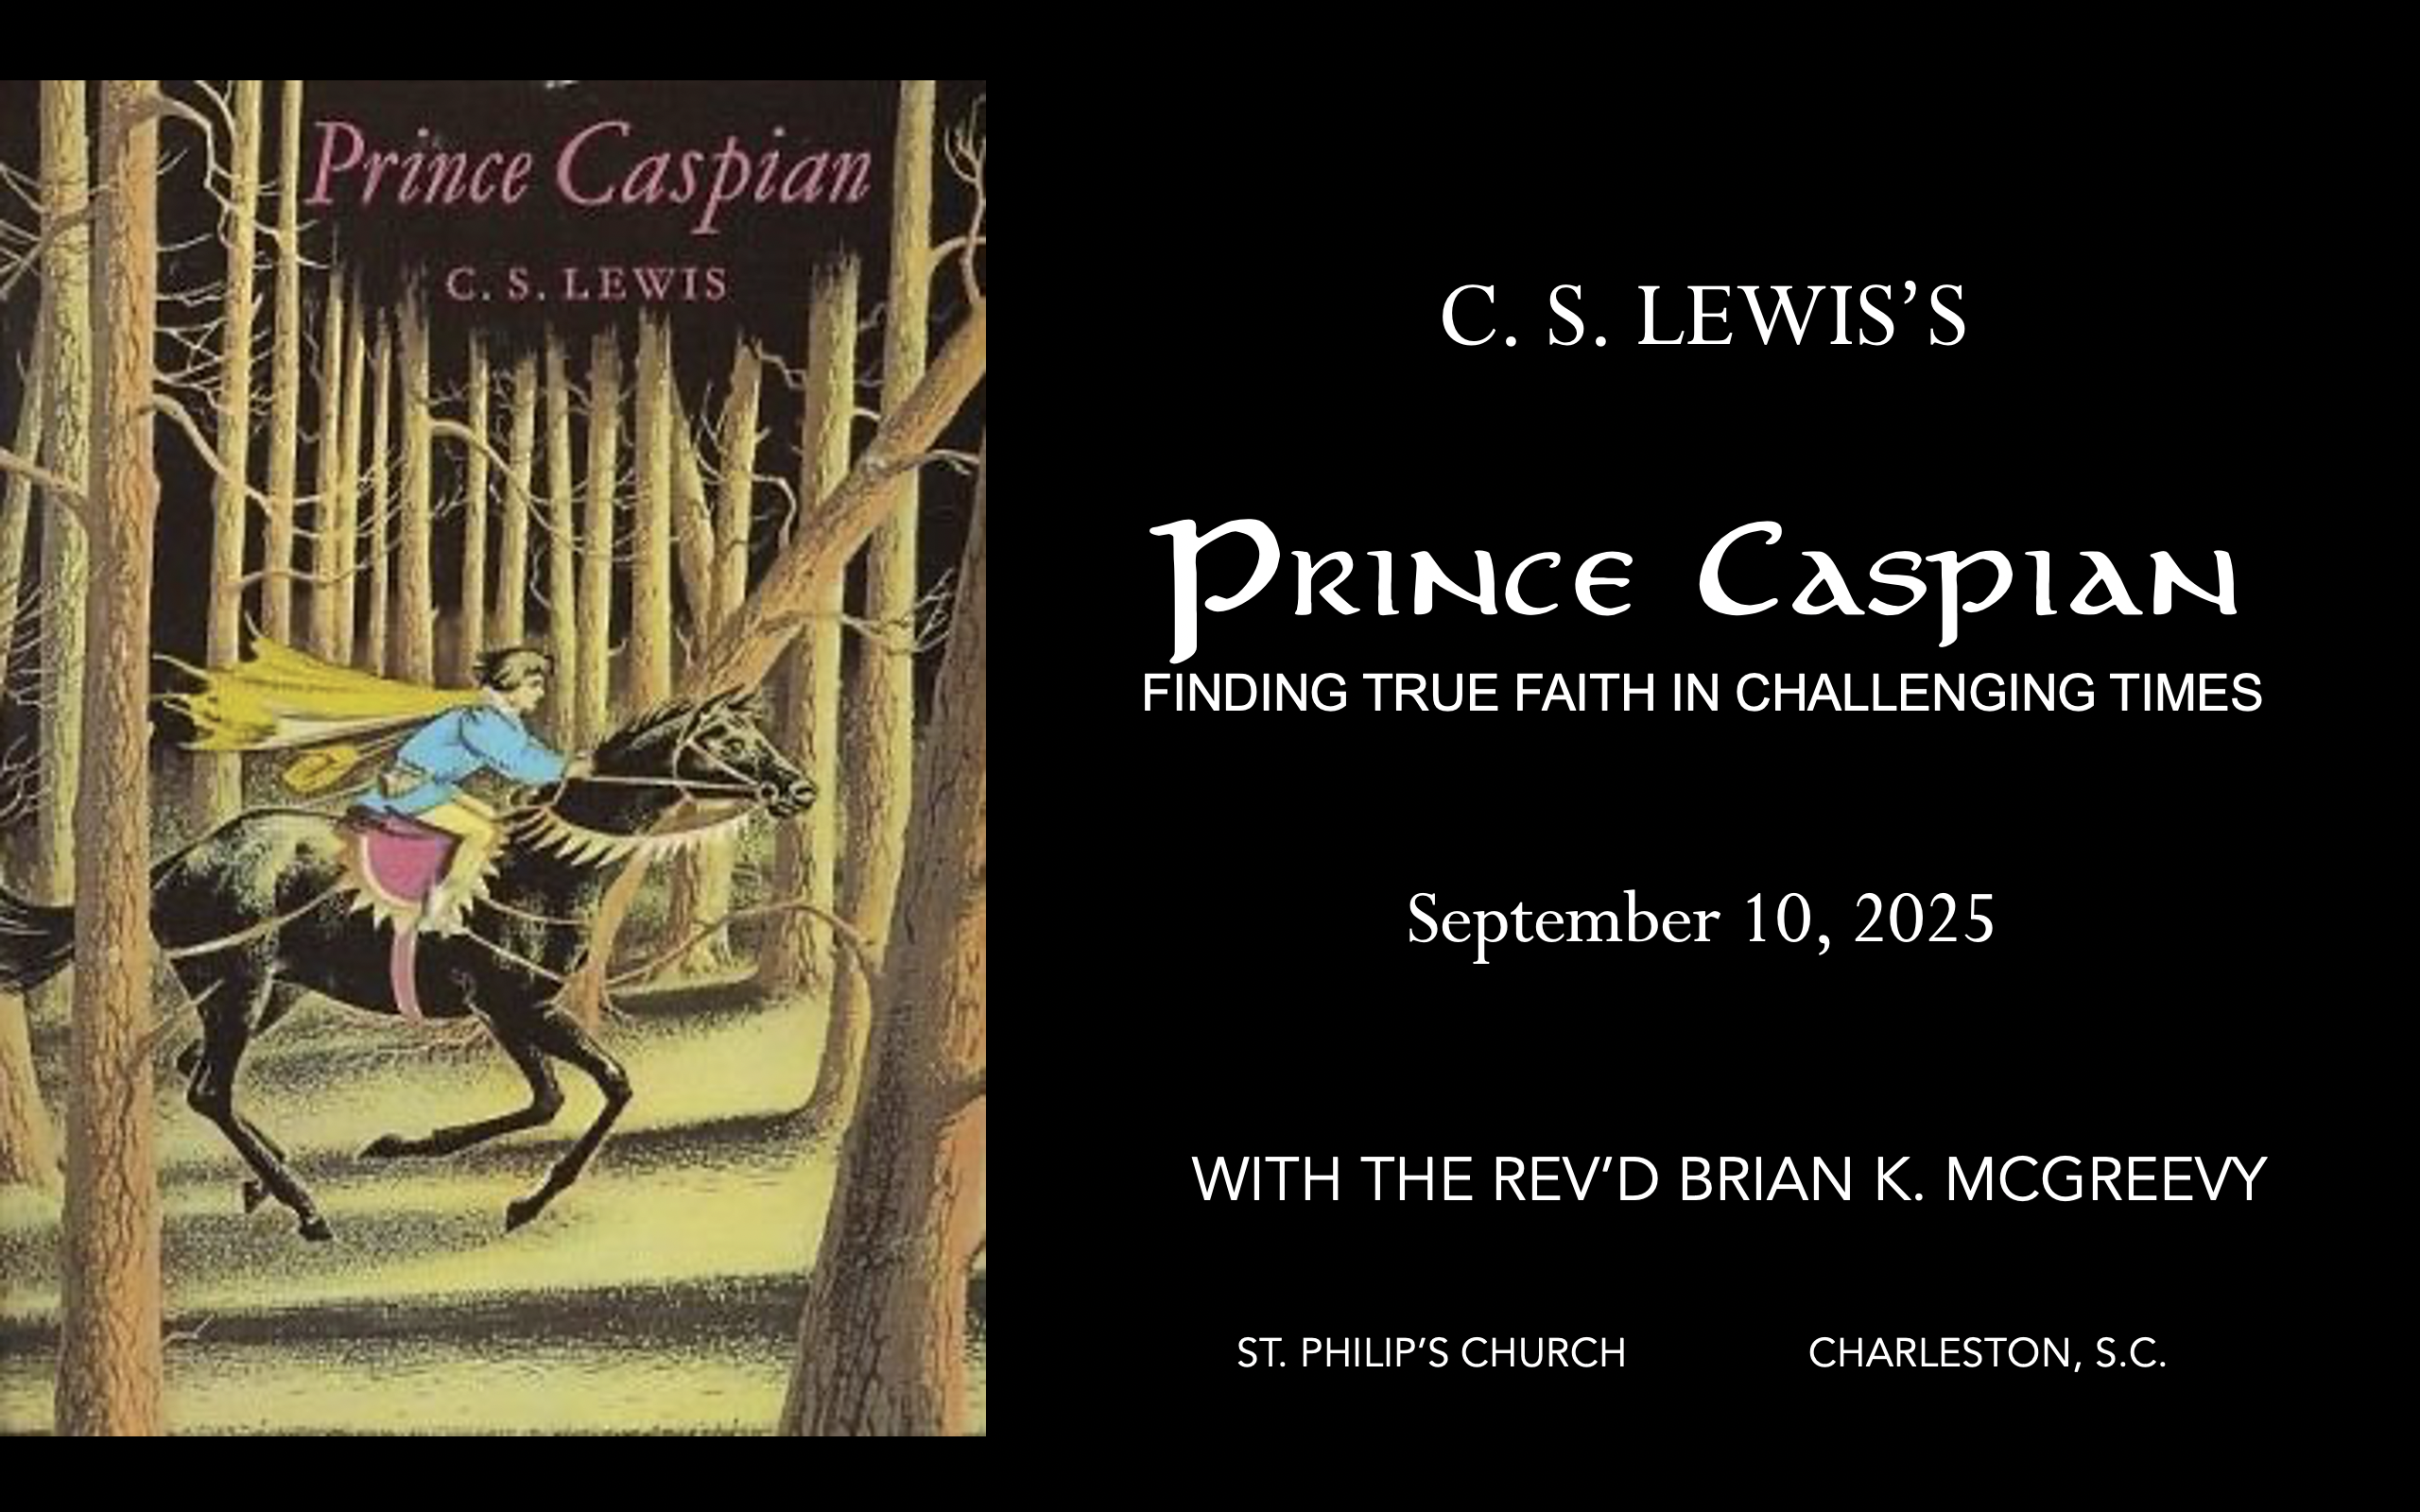

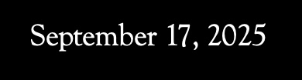
November 19, 2025
September 24, 2025
October 1, 2025
December 3, 2025
November 5, 2025
October 8, 2025
October 15, 2025
October 29, 2025
October 22, 2025
December 10, 2025

Slide 2
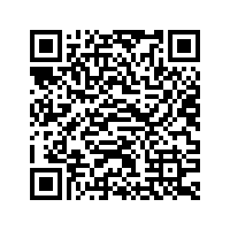
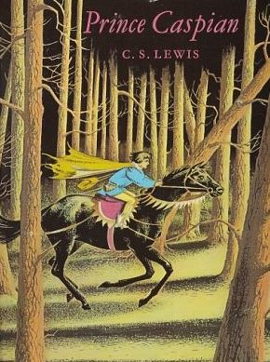
How to approach this class: How to approach this class:
--On the beach --Snorkeling --Scuba diving --Email list/QR code How to read this book: --Try reading aloud and slowly, looking for layers of meaning
--Look for themes/underline and highlight passages that resonate with you
What we’ll be doing:
--Setting the background and context
--Following the story chapter by chapter
--Drawing out principles for living with Joy and Purpose
--Looking at relevant Scripture

Slide 3
For you were once darkness, but now you are light in the Lord. Live as children of light (for the fruit of the light consists in all goodness, righteousness, and truth), and find out what pleases the Lord.
Have nothing to do with the fruitless deeds of darkness, but rather expose them. It is shameful even to mention what the disobedient do in secret. But everything exposed by the light becomes visible—and everything that is illuminated becomes a light. This is why it is said: “Wake up, sleeper, rise from the dead, and Christ will shine on you.” Be very careful, then, how you live— not as unwise but as wise, making the most of every opportunity because the days are evil.
Ephesians 5:8-15

Slide 4
Why Narnia matters SO much today Aggressively secular narrative pervading our culture—how to counter?
Which Story Can We Trust? Either
We are here by accident, meaningless products of a random process. We create our own identity and can only invent meaning and purpose in life and do our best to stay alive—even though there is no point to life. Sartre, Dawkins, Nietzsche, most schools OR
We are precious creatures made by and in the image of a loving God, who has created us for something special that we are asked to do. We have the privilege of being able to do good and experience purpose as we live by faith in Christ in His Kingdom. The witness of Scripture, the Church, and the saints
These two stories are totally incompatible. They can’t both be right: cognitive dissonance. So which do we trust? Other stories, like the Chronicles of Narnia, can help us here by highlighting dissonance or by creating a narrative we want to inhabit. So which do we trust? Is Jadis really the Queen of the realm of Narnia? OR Is she the White Witch, a usurper in Narnia, which is really the realm of the mysterious great and noble lion, Aslan? Gradually, one story about Narnia emerges as supremely plausible, as each individual story turns out to be part of this greater narrative. This grand narrative of interlocking stories makes sense of the riddles the children see and experience and reveals the character of each narrative. These stories teach that Biblical truth and the wisdom of the world cannot both be True---we need to learn to think critically because we are surrounded by falsehood.
We each have our unique story. But our own story needs to be brought into connection with a grand narrative, a big story which gives our story a new importance and significance. Why? Because we realize that our story is framed by something greater which gives us value and purpose. Lewis’s remarkable achievement in Narnia is to allow his readers to inhabit this big story, to get inside it and feel what it is like to be part of it. --Rev. Dr. Alister McGrath, Holder of the Andreas Idreos Chair in Science and Religion, Oxford University (Ph.D. in Molecular Biophysics, Doctor of Divinity in Theology, and Ph.D. in Intellectual History, at Oxford)

Slide 5
“The shaping of our loves, desires, and imagination thus happens primarily
The Narnia stories are deeply grounded in the Biblical story and its four major scenes of Creation, Fall, Redemption, and New Creation. The White Witch, Miraz, and other evil characters in the Narnia stories are all engaged in the evil enchantment of encouraging a
Disciplined Forgetting of Aslan, his Story, and the Deep Magic.

Slide 6
“The shaping of our loves, desires, and imagination thus happens primarily
Prince Caspian: Advent Edition
C.S. Lewis and the Incarnation
The central miracle asserted by Christians is the Incarnation.
They say that God became Man.
The Son of God became a man to enable men to become sons of God.
C.S. Lewis, in Miracles and Mere Christianity

Slide 7
From Miracles: The central miracle asserted by Christians is the Incarnation. They say that God became Man. Every other miracle prepares for this, or exhibits this, or results from this. Just as every natural event is the manifestation at a particular place and moment of Nature’s total character, so every particular Christian miracle manifests at a particular place and moment the character and significance of the Incarnation. There is no question in Christianity of arbitrary interferences just scattered about. It relates not a series of disconnected raids on Nature but the various steps of a strategically coherent invasion—an invasion which intends complete conquest and “occupation.” The fitness, and therefore credibility, of the particular miracles depends on their relation to the Grand Miracle; all discussion of them in isolation from it is futile… In the Christian story God descends to reascend. He comes down; down from the heights of absolute being into time and space, down into humanity; down further still, if embryologists are right, to recapitulate in the womb ancient and pre-human phases of life; down to the very roots and seabed of the Nature He created. But he goes down to come up again and bring the whole ruined world up with Him. One has the picture of a strong man stooping lower and lower to get himself underneath some great complicated burden. He must stoop in order to lift, He must almost disappear under the load before he incredibly straightens his back and marches off with the whole mass swaying on his shoulders.”

Slide 8
“Or else one has the picture of a diver, stripping off garment after garment, making himself naked, then flashing for a moment in the air, and then down through the green and warm and sunlit water into the pitch black, cold, freezing water, down into the mud and slime, then up again, his lungs almost bursting, back again to the green and warm and sunlit water, and then at last out into the sunshine, holding in his hand the dripping thing he went down to get. This thing is human nature; but associated with it, all nature, the new universe. “Now as myth transcends thought, Incarnation transcends myth. The heart of Christianity is a myth which is also a fact. The old myth of the Dying God, without ceasing to be a myth, comes down from the heaven of legend and imagination to the earth of history. It happens -- at a particular date, in a particular place, followed by defineable historical consequences. We pass from a Balder or an Osiris, dying nobody knows when or where, to a historical Person crucified (it is all in order ) under Pontius Pilate. By becoming fact it does not cease to be myth: that is the miracle.” (God in the Dock,

Slide 9
From C.S. Lewis’s Preface (1944) to Athanasius’s On the Incarnation (318 A.D.): “His epitaph is Athanasius contra mundum, "Athanasius against the world." We are proud that our own country has more than once stood against the world. Athanasius did the same. He stood for the Trinitarian doctrine, "whole and undefiled," when it looked as if all the civilised world was slipping back from Christianity into the religion of Arius - into one of those "sensible" synthetic religions which are so strongly recommended today and which, then as now, included among their devotees many highly cultivated clergymen. It is his glory that he did not move with the times; it is his reward that he now remains when those times, as all times do, have moved away. “When I first opened his De Incarnatione I soon discovered by a very simple test that I was reading a masterpiece. I knew very little Christian Greek except that of the New Testament and I had expected difficulties. To my astonishment I found it almost as easy as Xenophon; and only a master mind could, in the fourth century, have written so deeply on such a subject with such classical simplicity. Every page I read confirmed this impression. His approach to the Miracles is badly needed today, for it is the final answer to those who object to them as "arbitrary and meaningless violations of the laws of Nature." They are here shown to be rather the re-telling in capital letters of the same message which Nature writes in her crabbed cursive hand; the very operations one would expect of Him who was so full of life that when He wished to die He had to "borrow death from others." The whole book, indeed, is a picture of the Tree of Life - a sappy and golden book, full of buoyancy and confidence. We cannot, I admit, appropriate all its confidence today. We cannot point to the high virtue of Christian living and the gay, almost mocking courage of Christian martyrdom, as a proof of our doctrines with quite that assurance which Athanasius takes as a matter of course. But whoever may be to blame for that, it is not Athanasius.”

Slide 10
Excerpts from On the Incarnation: For this purpose, then, the incorporeal and incorruptible and immaterial Word of God entered our world. In one sense, indeed, He was not far from it before, for no part of creation had ever been without Him Who, while ever abiding in union with the Father, yet fills all things that are. But now He entered the world in a new way, stooping to our level in His love and Self-revealing to us. --He saw the reasonable race, the race of men that, like Himself, expressed the Father’s Mind, wasting out of existence, and death reigning over all in corruption. He saw that corruption held us all the closer, because it was the penalty for the Transgression; He saw, too, how unthinkable it would be for the law to be repealed before it was fulfilled. He saw how unseemly it was that the very things of which He Himself was the Artificer should be disappearing. He saw how the surpassing wickedness of men was mounting up against them; He saw also their universal liability to death. All this He saw and, pitying our race, moved with compassion for our limitation, unable to endure that Death should have the mastery, rather than that His creatures should perish and the work of His Father for us men come to nought, He took to Himself a body, a human body even as our own. Nor did He will merely to become embodied or merely to appear; had that been so, He could have revealed His divine majesty in some other and better way. --No! He took our body, and not only so, but He took it directly from a spotless, stainless virgin, without the agency of human father—a pure body, untainted by intercourse with man. He, the Mighty One, the Artificer of all, Himself prepared this body in the virgin as a temple for Himself, and took it for His very own, as the instrument through which He was known and in which He dwelt. Thus, taking a body like our own, because all our bodies were liable to the corruption of death, He surrendered His body to death instead of all, and offered it to the Father. This He did out of sheer love for us, so that in His death all might die, and the law of death thereby be abolished because, having fulfilled in His body that for which it was appointed, it was thereafter voided of its power for men. This He did that He might turn again to incorruption men who had turned back to corruption, and make them alive through death by the appropriation of His body and by the grace of His resurrection. Thus He would make death to disappear from them as utterly as straw from fire.

Slide 11
“The Savior is working mightily among men, every day He is invisibly persuading numbers of people all over the world, both within and beyond the Greek-speaking world, to accept His faith and be obedient to His teaching. Can anyone, in face of this, still doubt that He has risen and lives, or rather that He is Himself the Life? Does a dead man prick the consciences of men, so that they throw all the traditions of their fathers to the winds and bow down before the teaching of Christ? If He is no longer active in the world, as He must needs be if He is dead, how is that He makes the living to cease from their activities, the adulterer for his adultery, the murderer from murdering, the unjust from avarice, while the profane and godless man becomes religious? If He did not rise, but is still dead, how is it that He routs and persecutes and overthrows the false gods, whom unbelievers think to be alive, and the evil spirits whom they worship? For where Christ is named, idolatry is destroyed and the fraud of evil spirits is exposed; indeed, no such spirit can endure that Name, but takes to flight on sound of it. This is the work of One Who lives, not of one dead; and, more than that, it is the work of God. “For of what use is existence to the creature if it cannot know its Maker?” “….it was our sorry case that caused the Word to come down, our transgression that called out His love for us, so that He made haste to help us and to appear among us. It is we who were the cause of His taking human form, and for our salvation that in His great love He was both born and manifested in a human body.” “How could He have called us if He had not been crucified, for it is only on the cross that a man dies with arms outstretched?” “He deals with men as a good teacher with his pupils, coming down to their level and using simple means. St. Paul says as much: “Because in the wisdom of God the world in its wisdom knew not God, God. thought fit through the simplicity of the News proclaimed to save those who believe.” (1 Cor. 1: 23) Men had turned from the contemplation of God above, and were looking for Him in the opposite direction, down among created things and things of sense. The Saviour of us all, the Word of God, in His great love took to Himself a body and moved as Man among men, meeting their senses, so to speak, halfway.”

Slide 12
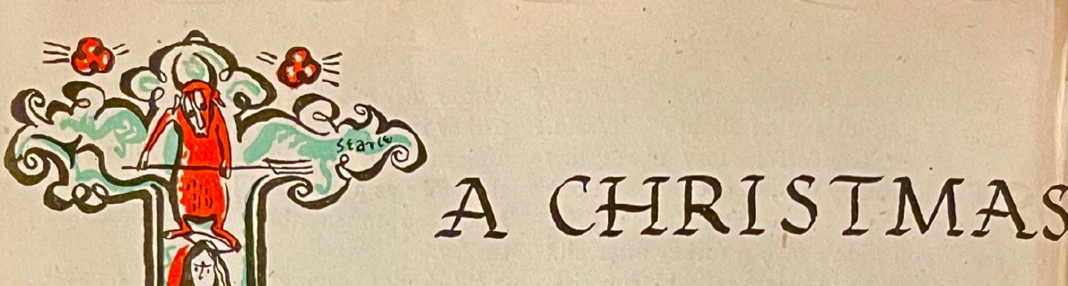
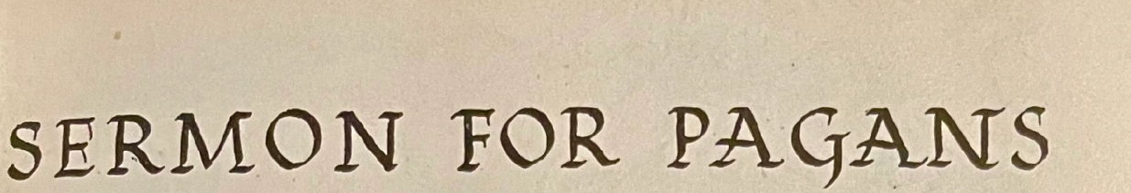
“A Christmas Sermon for Pagans” by C. S. Lewis Strand Magazine, Vol. 112, Issue 672, December 1946 Writing religion for sceptics has made C. S. Lewis a best-seller. His books on Christianity—chief among them “The Screwtape Letters”—sell better, and read more easily, than most crime stories. This sermon isa characteristic piece of writing by the Oxford don who has become the most entertaining missionary of our time “When I was asked to write a Christmas sermon for pagans, I accepted the job light-heartedly enough, but now that I sit down to tackle it, I discover a difficulty: are there any pagans in England for me to write to? I know that people keep on telling us that this country is relapsing into paganism; but they only mean that it is ceasing to be Christian, and is that at all the same thing? “Let us remember what a pagan or heathen (I use the words interchangeably) really was. A heathen was a man who lived out on the heath, out in the wilds. A pagan was a man who lived in a "pagus" or small village. Both words in fact meant a rustic or yokel. They date from the time when the larger towns of the Roman Empire were already Christianised, but the old nature religions still lingered in the country. Pagans or heathens were the backward people in the remote districts who had not yet been converted, who were still pre-Christians. To say that modern people who have drifted away from Christianity are pagans is to suggest that a post-Christian man is the same as a pre-Christian man. But that is like thinking that a woman who has lost her husband is the same sort of person as an unmarried girl. Or that a street where the houses have been knocked down is the same as a field where no house has yet been built. The ruined street and the unbuilt field are alike in one respect, namely that neither will keep you dry if it rains, but they are different in every other respect: rubble, dust, broken bottles, old bedsteads, and stray cats are very different from grass, thyme, clover, buttercups, and the lark singing overhead. “The real pagan differed from the post-Christian in the following ways. Firstly, he was religious. From the Christian point of view, he was indeed too religious by half. He was full of reverence.

Slide 13
“For him the earth was holy, the woods and waters were alive. His agriculture was a ritual as well as a technique. And secondly, he believed in what we now call "an objective right and wrong". That is, he thought the distinction between pious and impious acts was something that existed independently of human opinions: something like the multiplication table, which man had not invented, but had found to be true, and which he had better take notice of. The gods would punish him if he did not. “To be sure, by Christian standards his list of right and wrong acts was rather a muddled one. He thought (and the Christians agreed) that the gods would punish him for setting the dogs on a beggar who came to his door, or for striking his father. But he also thought they would punish him for turning his face to the wrong point of the compass when he began ploughing. Though his code included some fantastic sins and duties, it got in most of the real ones. This leads us to the third great difference between a pagan and a post-Christian man. Believing in a real right and wrong means finding out that you are not very good. The pagan code may have been on some points a low one, but it was too high for the pagan to live up to. Hence a pagan, though in many ways merrier than a modern, had a deep sadness. When he asked himself what was wrong with the world, he did not immediately reply "the social system" or "our allies" or "education". It occurred to him that he -- himself -- might be one of the things that was wrong with the world. He knew he had sinned. And the terrible thing was he thought the gods made no difference between voluntary and involuntary sins. You might get into their bad books by mere accident. And once in, it was very hard to get out of them. The pagan dealt with this situation in a rather silly way. His religion was a mass of ceremonies, sacrifices, purifications, et cetera, which were supposed to take away guilt, but they never quite succeeded. His conscience was not at ease. “Now, the post-Christian view which is gradually coming into existence (it is complete already in some people, and still incomplete in others) is quite different. According to it, nature is not a living thing to be reverenced. It is a kind of machine for us to exploit. There is no objective right or wrong. Each race or class can invent its own code or ideology just as it pleases. And whatever may be amiss with the world, it is certainly not we the ordinary people. It is up to God, if after all he should happen to exist, or to government, or to education, to give us what we want. They are the shop, we are the customer, and the customer is always right.

Slide 14
Now if the post-Christian view is the correct one then we have indeed woken from a nightmare. The old fear, the old reverence, the old restraints... how delightful to have woken up into freedom, to be responsible to no one, to be utterly and absolutely our own masters! We have, of course, lost some fun. A universe of colourless electrons (which is presently going to run down and annihilate all organic life everywhere and forever) is, perhaps, a little dreary compared with the earth-mother and the sky-father, the wood nymphs and the water nymphs, chaste Diana riding the night sky and homely Vesta flickering on the hearth. But one can't have everything, and there are always the flicks and the radio: if the new view is correct, it has very solid advantages. “But is it? And if so, why are things not going better? What do you make of the present threat of world famine? We know now it is not entirely due to the war. From country after country comes the same story of failing harvests. Even the whales have less oil. Can it be that nature, or something behind nature, is not simply a machine that we can do what we like with? That she is hitting back? Waive the point. Suppose she is only a machine, and that we are free to master her at our pleasure. Have you not begun to see that man's conquest of nature is really man's conquest of man? That every power wrested from nature is used by some men over other men? Men are the victims, not the conquerors in this struggle. Each new victory over nature yields new means of propaganda to enslave them, new weapons to kill them, new power for the state, and new weakness for the citizen. New contraceptives to keep man from being born at all. As for ideologies, does no one see the catch? If there is no real wrong and right -- nothing good or bad in itself -- none of these ideologies can be better or worse than another. For a better moral code can only mean one which comes nearer to some real or absolute code. One map of New York can be better than another only if there is a real New York for it to be truer to. If there is no objective standard then our choice between one ideology and another becomes a matter of arbitrary taste. Our battle for democratic ideals against Nazi ideals has been a waste of time, because the one is no better than the other. Nor can there ever be any real improvement or deterioration. If there is no real goal, we can't get any nearer to it, or farther from it. In fact there is no real reason for doing anything at all.

Slide 15
”It looks to me, neighbours, as though we shall have to set about becoming true pagans, if only as a preliminary to becoming Christians. I don't mean that we should begin leaving little bits of bread under the tree at the end of the garden as an offering to the dryad. I don't mean that we should dance to Dionysus across Hampstead Heath, though perhaps a little more solemn or ecstatic gaiety and a little less commercialised amusement might make our holidays better than they now are. I don't even mean (though I do very much wish) that we should recover that sympathy with nature, that religious attitude to the family, and that appetite for Beauty which the better pagans had. Perhaps what I do mean is best put like this: if the modern post-Christian view is wrong (and every day I find it harder to think it right) then there are three kinds of people in the world. 1) Those who are sick and don't know it: the post-Christians; 2) Those who are sick and know it: the pagans; and 3) Those who have found the cure. “And if you start in the first class, you must go through the second to reach the third. For (in a sense) all that Christianity adds to paganism is the cure. It confirms the old belief that in this universe we are up against Living Power: that there is a real Right and that we have failed to obey it: that existence is beautiful and terrifying. It adds a wonder of which paganism had not distinctly heard: that the Mighty One has come down to help us, to remove our guilt, to reconcile us. All over the world, even in Japan, even in Russia, men and women will meet on December the 25th to do a very old-fashioned and very pagan thing: to sing and feast because God has been born. “You are uncertain whether it is more than a myth. Well, if it is only a myth then our last hope is gone. But is the opposite explanation not worth trying? Who knows but that here -- and here alone -- lies your way back? Not only to heaven, but to earth too, and to the great human family whose oldest hopes are confirmed by this story that does not die.”

Slide 16
OF THE FATHER'S LOVE BEGOTTEN Of the Father's love begotten, Ere the worlds began to be, He is Alpha and Omega, He the source, the ending He, Of the things that are, that have been, And that future years shall see, Evermore and evermore. At his word the worlds were framèd; He commanded, it was done: Heav’n and earth and depths of ocean, In their threefold order one; All that grows beneath the shining Of the moon and burning sun— Evermore and evermore. He was found in human fashion, Death and sorrow here to know, That the race of Adam’s children, Doomed by law to endless woe, May not henceforth die and perish In the dreadful gulf below— Evermore and evermore. O that birth forever blessèd, When the virgin, full of grace, By the Holy Ghost conceiving, Bore the Savior of our race, And the babe, the world’s Redeemer, First revealed his sacred face— Evermore and evermore. This is he whom seers in old time Chanted of with one accord, Whom the voices of the prophets Promised in their faithful word; Now he shines, the long-expected; Let creation praise its Lord— Evermore and evermore. O ye heights of Heav’n adore him! Angel hosts his praises sing! All dominions bow before him And exalt our God and King. Let no tongue on Earth be silent, Every voice in concert ring— Evermore and evermore. Christ! to thee with God the Father, And O Holy Ghost, to thee, Hymn and chant and high thanksgiving And unwearied praises be, Honor, glory, and dominion, And eternal victory— Evermore and evermore. Aurelius Clemens Prudentius, 398 AD

Slide 17
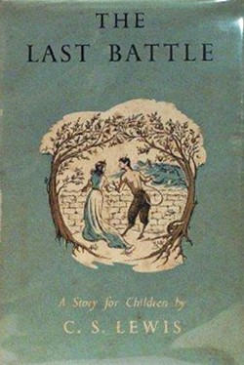
Collect for Advent Sunday Almighty God, give us grace, that we may cast away the works of darkness, and put upon us the armor of light, now in the time of this mortal life, in the which thy son Jesus Christ came to visit us in great humility; that in the last day when he shall come again in his glorious majesty to judge both the quick and the dead, we may rise to the life immortal, through him who liveth and reigneth with thee and the Holy Ghost now and ever. Amen. Thomas Cranmer, 1549

